Slide 1
Intergenerational Social Skills
and Social Media Usage
Stephen Yezukevicz, Daniel Mello, Eliel Mares
Notes:
Eliel

Slide 2
Research Questions
“How do social networking platforms influence the formation of social skills?”
We aimed our research to answer these questions based on the above question:
Which social skills do different generations show the greatest aptitude towards expressing?
Does the expression of social skills change depending on whether or not a situation is framed in an in-person or online context?
Which social skills are most developed as a result of early exposure to social media?
Notes:
Eliel

Slide 3
Sample Frame and Sample Size
We received 8 participants in each generation
Gen Z (0-22), (Present - 1998)
Millennials (23-35), 1997-1985)
Gen X (36-52) (1984-1968)
Boomer (53-76) (1967-1944)
Notes:
Eliel

Slide 4
Method
Created three questionnaires using Google Forms
We looked at 6 different types of social skills
Physical (real life) social skills:
Directness
Empathy
Meaningful discussion
Internet social skills:
Precise Communication
Idiom Comprehension
Cultural Literacy
Notes:
Eliel
We sent out each survey individually to the same participants on seperate days
Each time the survey was sent out between the hours of 3pm-5pm
Allowing the individual to go throughout their day and be exposed to social media

Slide 5
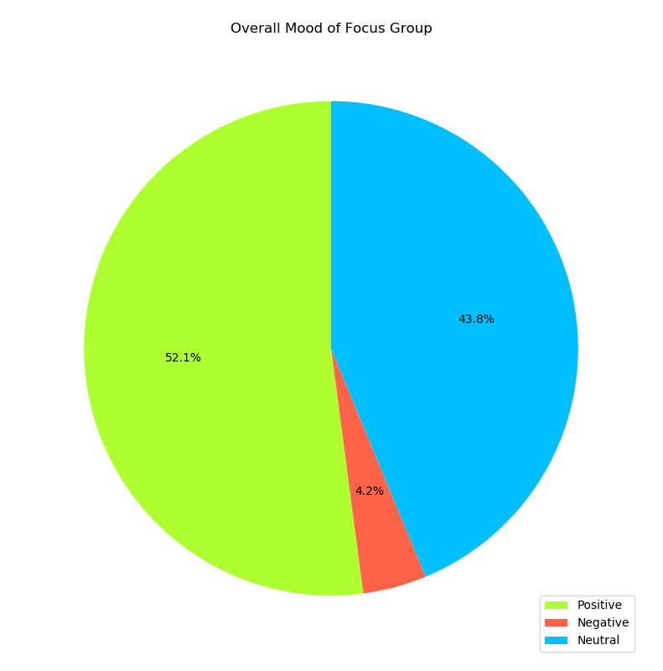
Mood
Each participant was asked about their mood each time they took a survey.
This helped keep our data accurate as we were able to see if their responses were affected by their mood.
Notes:
Stephen

Slide 6
Physical Social skills
Directness, Empathy, Meaningful Discussion
Each generation earned points based on how much a specific answer correlated with a particular social skill. These points were used in calculating percentages.
(0 points for the least-correlated response, 3 points for the most-correlated response)
Notes:
Stephen

Slide 7
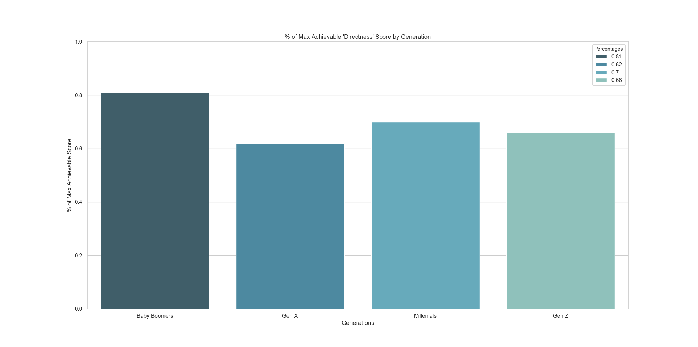
Directness
Notes:
Stephen

Slide 8
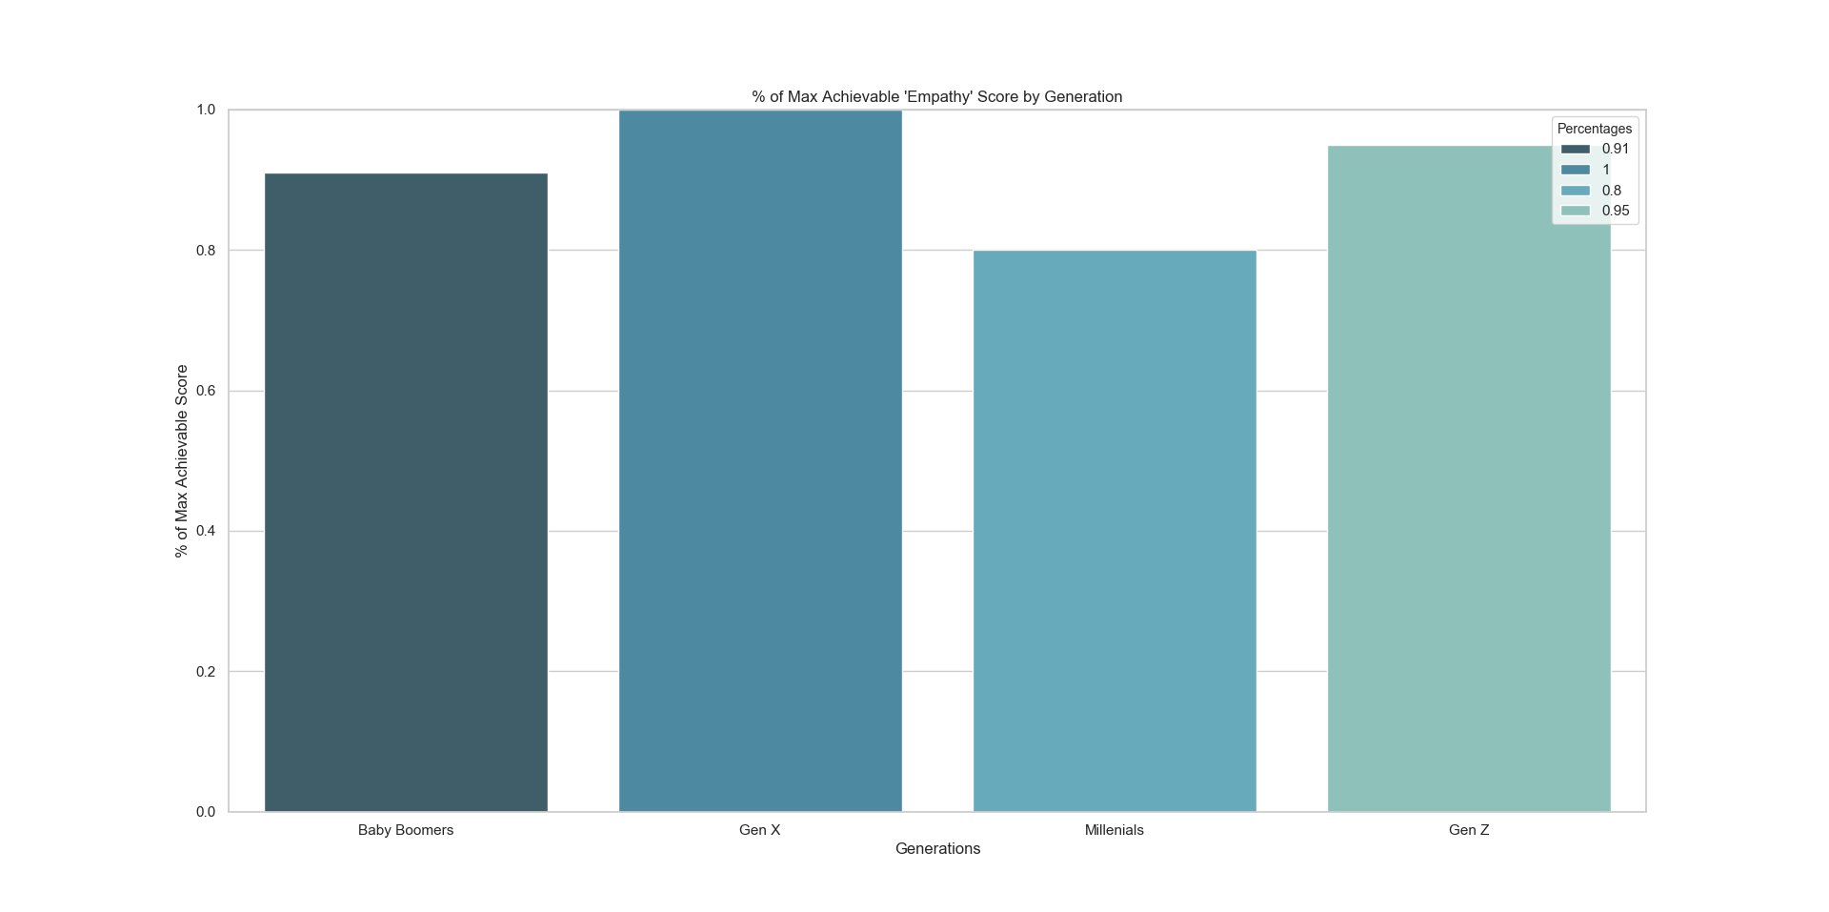
Empathy
Notes:
Stephen

Slide 9
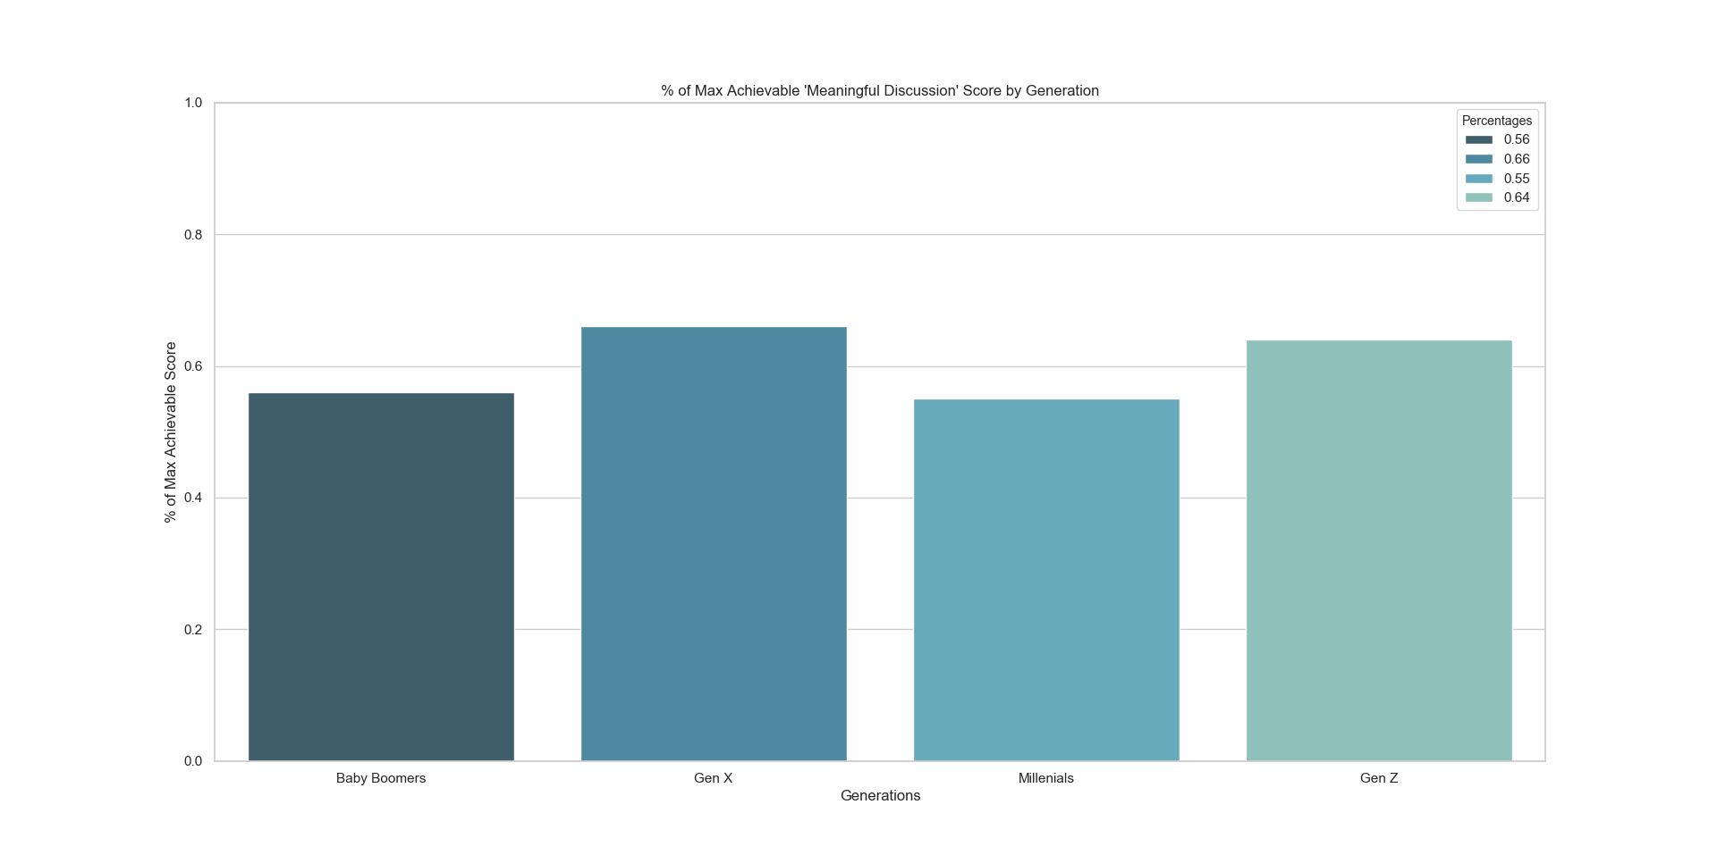
Meaningful Discussion
Notes:
Stephen

Slide 10
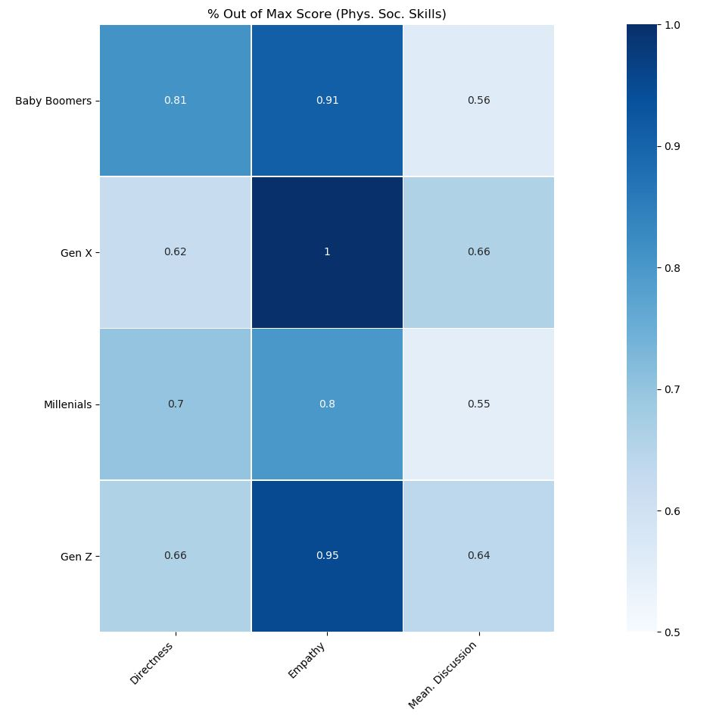
Physical
Social
Skills
Analysis
Notes:
Stephen

Slide 11
Internet Social Skills
Precise Communications, Idiom Comprehension, Cultural Literacy
Each generations answers were categorized into 3 groups by their responses to each Internet Social Skill question.
Correct
Incorrect
“I Don’t Know”
The number of each response was tallied and graphed.
Notes:
Dan

Slide 12
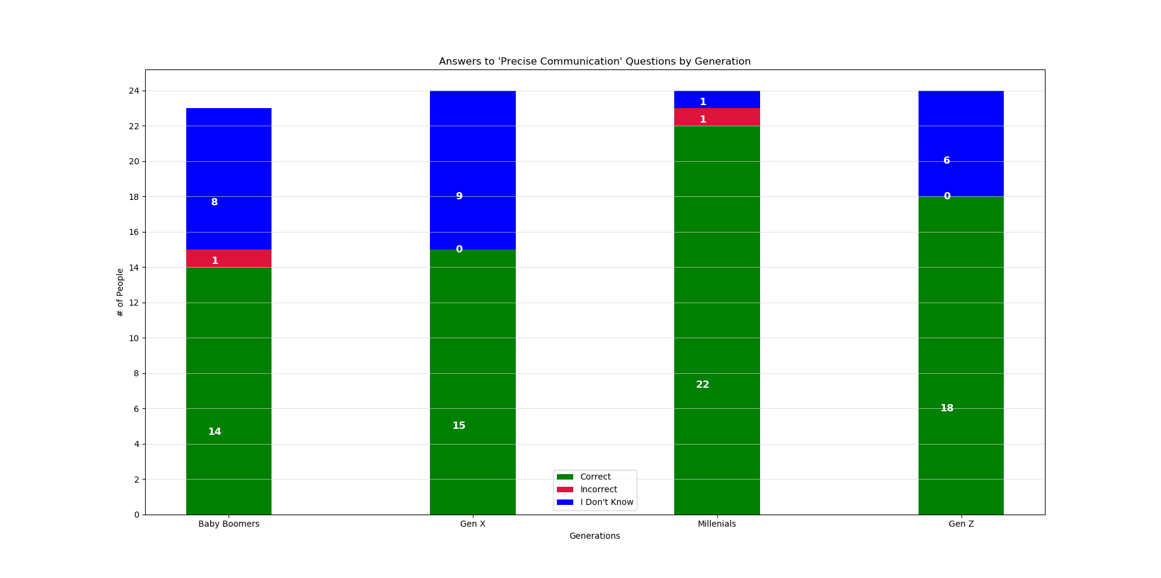
Precise Communication
Notes:
Dan

Slide 13
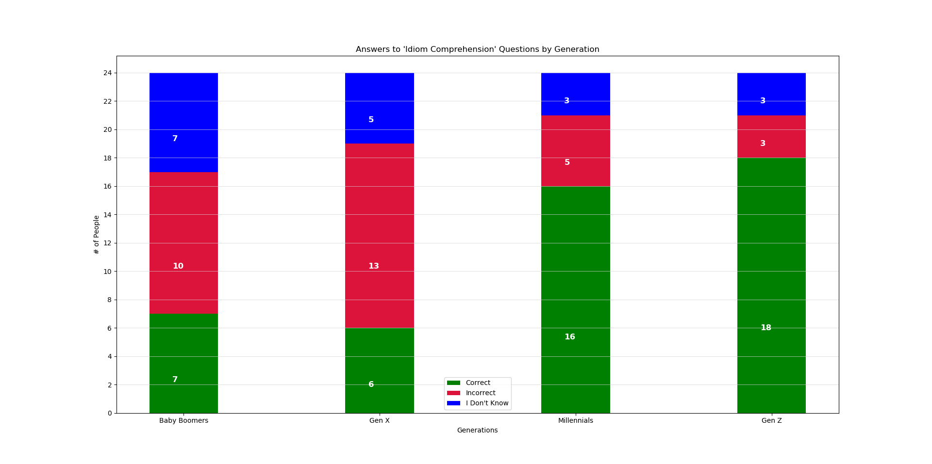
Idiom Comprehension
Notes:
Dan

Slide 14
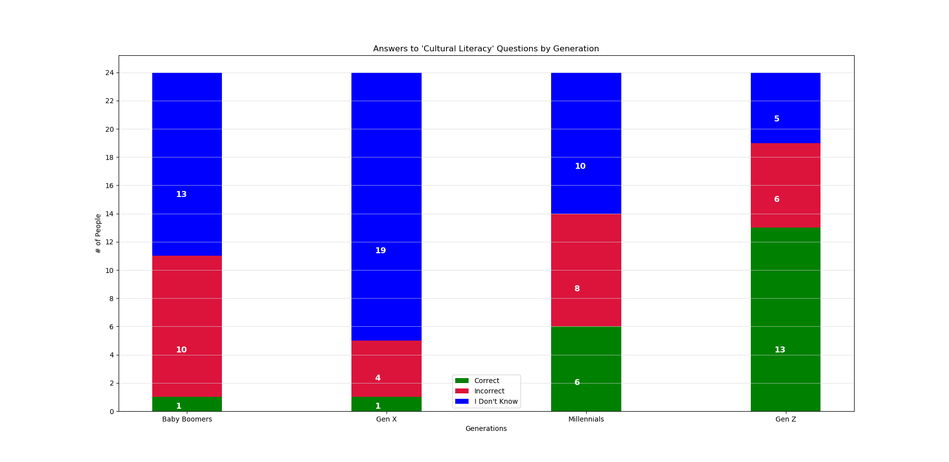
Cultural Literacy
Notes:
Dan

Slide 15
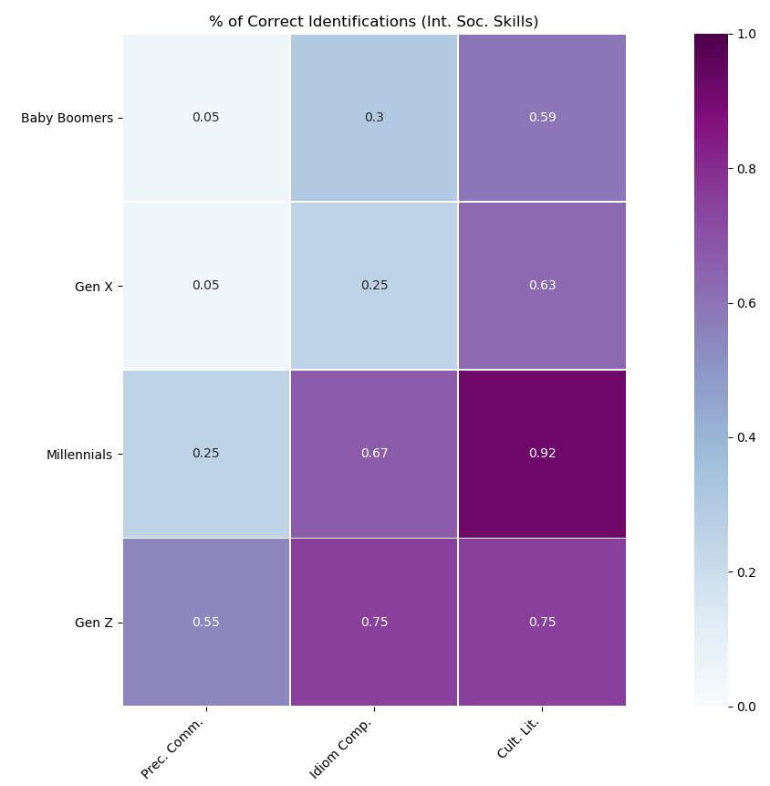
Internet Social Skills Analysis
Notes:
Dan

Slide 16
Conclusion
Our Major Claims
Baby Boomers exhibit more Direct behavior.
Generation X exhibits more Empathetic behaviors.
As the generations get younger, the exhibition of Internet social skills increases.
The younger generations also have a decrease in exhibiting physical social skills.
Notes:
Dan

